Slide 1
Human Conduct
&
Guidelines for
Professional Ethics

Slide 2
Implications of the Right Understanding
Contents:
The Basis for Universal Human Values and Ethical Human Conduct
Professional Ethics in the Light of Right Understanding
Holistic Development towards Universal Human Order
Vision for Holistic Technologies, Production Systems
and Management Models

Slide 3
The Basis for Universal Human Values and Ethical Human Conduct
Definitiveness of Ethical Human Conduct
Every Unit has a specific definitiveness
Examples:
A mango tree has a definite ‘mango-ness’
Iron has a definite ‘iron-ness’
Cow has a definite ‘cow-ness’
Does the human being has any definitiveness ?

Slide 4
The Basis for Universal Human Values and Ethical Human Conduct
Definitiveness in Human Being
The right understanding gained through self-exploration enables us to identify the definitiveness of human conduct which may also be called the ethical human conduct. It is the same for all human beings.

Slide 5
The Basis for Universal Human Values and Ethical Human Conduct
Definitiveness in Human Being
Definite human conduct is the sum total of the state of harmony within, expressing itself and participating in harmony with the outside world. The harmony in the Self is naturally expressed and extended at all levels of our being as follows:
Harmony at the level of Self - Happiness
Harmony of the Self with the Body - Health at the level of body
Harmony in the family, in human-human Relationship - Mutual happiness, justice, fearlessness.
Harmony with rest of nature - Mutual prosperity: prosperity in human being and preservation of rest of nature
Harmony with the whole of nature/Existence - Co-existence (mutual fulfilment)

Slide 6
The Basis for Universal Human Values and Ethical Human Conduct
Ethical Human Conduct
Ethical Human Conduct constitutes :
Values
Policy
Character

Slide 7
Definite (Ethical) Human Conduct (Manaviya Acharan)
Right Understanding Values
– What to do
Thought Policy – How to do
Behaviour/Work Character – Doing
Right Understanding → Natural acceptance of human values, definiteness in participation, definite human conduct
(development of human consciousness)

Slide 8
The Basis for Universal Human Values and Ethical Human Conduct
Ethical Human Conduct
Values: Understanding of role of Human Being in Existence
Once we have the right understanding (relationship, harmony and co-existence), we are able to see our natural participation or values at all levels of being – from individual, to family, society, nature/existence.
This participation or the human values are definite and form the basis of our ethical human conduct.

Slide 9
The Basis for Universal Human Values and Ethical Human Conduct
Ethical Human Conduct
Policy: Thought of how to express (live with) Human Values
Having identified the definite human values, these become the guide to our imagination (desire, thought and expectation). Our imaginations are always in terms of how to fulfil this participation, how to live with these values. The comprehensive analysis of how to live with these values, how to express these values is what policy is. These policies are, therefore, naturally conducive to human welfare – conducive to enrichment, protection and right utilization of self, body and physical resources; and at the same time, they are conducive to the welfare of every unit in existence.

Slide 10
The Basis for Universal Human Values and Ethical Human Conduct
Ethical Human Conduct
Character: Expression of Human Values in Behaviour, Work and Participation in the Larger Order
This can be understood in terms of the following:
Honesty in conjugal relationship i.e. honesty in husband-wife relationship.
Rightful acquisition and utilization of wealth – by way of labour, using cyclic and mutually enriching production processes (such as agriculture, manufacturing of clothes, construction of buildings, machine manufacturing, etc.)
Kindness in behaviour and work – ensuring justice in behaviour and preservation of rest of nature in work, leading to fulfilment of the comprehensive human goal; at the same time, compensating for deficiencies created in the past.

Slide 11
A. Knowledge of Human Conduct
1. Human Values – Understanding "What to do as a human being" and "What not to do as a human being"
2. Policy – Detail, thought of "how to do" Human Constitution Includes plan, program, implementation, results, evaluation
    Policy for enrichment (arth neeti) of Self (I), Body, Physical Facility
    Policy for protection (rajya neeti) of Self (I), Body, Physical Facility
    Policy for right utilisation (dharm neeti) of Self (I), Body, Physical Facility
3. Character – Compassionate behaviour, work & participation in larger order on the basis of human values
    Behaviour – ensuring justice, mutual happiness
    Work – ensuring suraksha, mutual prosperity
    Rightfully acquired wealth (swa-dhan)
    Honesty in conjugal relationship

Slide 12
The Basis for Universal Human Values and Ethical Human Conduct
Ethical Human Conduct
‘Ethical conduct’ implies that it is naturally acceptable to me and does not give rise to conflict within.
‘Ethical conduct’ implies that it is in consonance with the right understanding of the reality – the underlying harmony at all levels.
‘Ethical conduct’ implies that it leads to mutual fulfilment with other people and mutual enrichment with rest of nature
Thus, the ‘ethical conduct’ is self-satisfying, people-friendly and eco-friendly.

Slide 13
The Basis for Universal Human Values and Ethical Human Conduct
Implications of Value-Based Living
At the level of individual:
Transition towards happiness and prosperity will take place at the individual level.
The individual will slowly start getting rid of the contradictions and conflicts within, and attain a state where he is able to answer his/her questions by exploring within the Self.
This will help the individual get rid of the tension, frustration, depression, one-manship, psycho-somatic disorders and other such situations that he doesn’t want to be in and facilitate definite and predictable human conduct.

Slide 14
The Basis for Universal Human Values and Ethical Human Conduct
Implications of Value-Based Living
At the level of Family:
The value-based living will facilitate peace and harmony in the family, with more occurrences of just and fulfilling behaviour.
People will feel prosperous and the feeling to nurture others will grow in the families. This will help raise the feeling of togetherness in the families, and reduce the family fights.
The prevalent problems in joint families will also fade away, once human living is based on human consciousness.

Slide 15
The Basis for Universal Human Values and Ethical Human Conduct
Implications of Value-Based Living
At the level of Society:
When relationship gets higher priority over physical facility, fearlessness and mutual trust develops in the society.
Discrimination on the basis of body (in terms of gender, age or race), physical facility (in terms of wealth or posts) and beliefs (in terms of isms, sects, etc.) will be reduced.
The conflicts between communities and nations which are manifesting in naxalism, terrorism, communalism and international conflicts etc. can be solved to a large extent without any coercion or war.
The feeling of undividedness will surface in the society. Fulfilment of human goal will be first in our plans and projects at all levels and gradually a human order based on trustful relationships will slowly emerge.

Slide 16
The Basis for Universal Human Values and Ethical Human Conduct
Implications of Value-Based Living
At the level of Nature:
Human beings will be in a better position to place themselves in relation with other units in nature.
The problems of pollution and resource depletion can be handled smoothly when people are able to judge appropriately their needs for physical facility themselves and the mode of fulfilment is eco-friendly.
Better methods of farming and production will help cut down problems of greenhouse gases, ozone depletion, ecological imbalance, etc.
The population of animals and birds can be saved from extinction and forests can be replenished.

Slide 17
B. Professional Ethics in the Light of Right Understanding
Professional ethics can be seen as the code of ethical conduct of the profession. Ethical conduct of profession implies the right utilization of one’s professional skills in the larger order towards the fulfilment of comprehensive human goal.

Slide 18
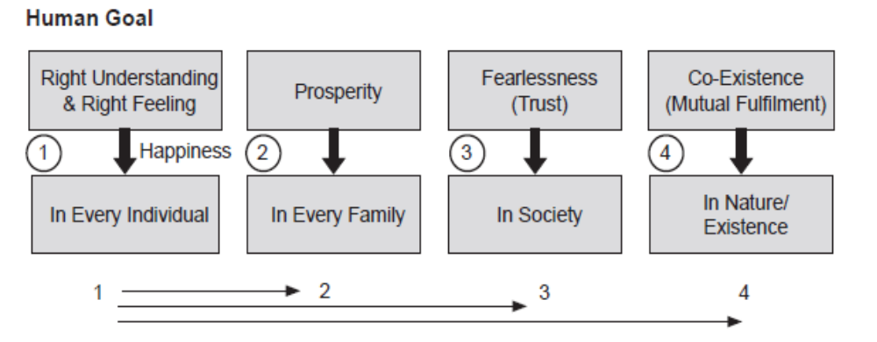
B. Professional Ethics in the Light of Right Understanding
Profession – In Context with the Comprehensive Human Goal
Any profession is a mode of participation by human beings in the larger order in pursuance of comprehensive human goal.

Slide 19
B. Professional Ethics in the Light of Right Understanding
Main Features Characterizing Ethical Competence
Clarity about the comprehensive human goal.
Confidence in oneself as well as confidence in the harmony, co-existence and self-regulation prevailing in entire existence, based on the right understanding of oneself and the rest of existence.
Competence of mutually fulfilling behaviour, clarity and confidence in ethical human conduct and its correlation with sustainable personal as well as collective happiness and prosperity.
Competence of mutually enriching interaction with nature, ability to appropriately assess the needs for physical facility for oneself, the family and society as well as their sustainable fulfilment through production systems ensuring harmony with nature.
Holistic vision about technologies, production systems and management
techniques.

Slide 20
B. Professional Ethics in the Light of Right Understanding
Issues in Professional Ethics – The Current Scenario
Corruption in multiple forms and at various levels
Tax evasion, misappropriation and misuse of public funds
Misuse of political power and bureaucratic authority
Misleading propaganda, unethical advertisements and sales promotion
Cut-throat competition
Exploiting the weakness of consumers through various enticing, bewildering
advertisements
Adulteration and spurious production
Endangering the health and safety of public at large
Hoarding and over-charging etc.

Slide 21
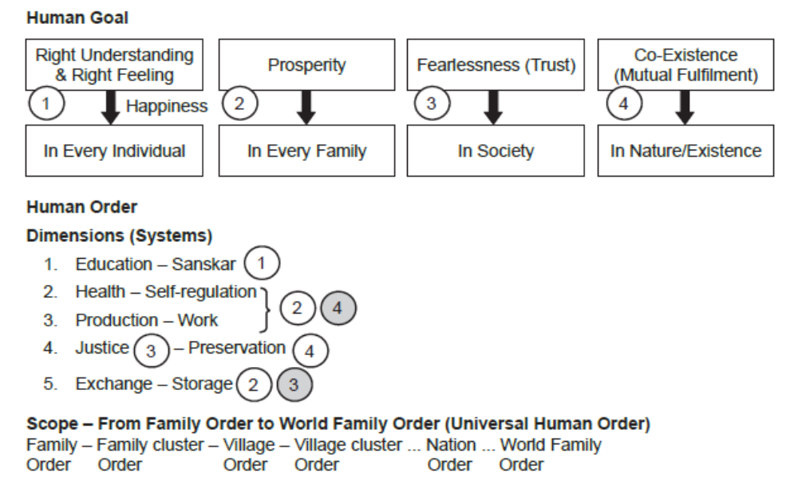
C. Holistic Development towards Universal Human Order
Visualization of Comprehensive Human Goal

Slide 22
C. Holistic Development towards Universal Human Order
The Vision for Holistic Development and Universal Human Order
On the basis of the understanding of harmony, we get the notion of an undivided society and universal human order. The universal human order will involve:
1. A holistic pattern in all the dimensions of human activity in the society including education, health-self-regulation, production-work, justice-preservation and exchange-storage etc.
2. Harmonious networking between the basic unit and their clusters successively moving from family order to world family order as follows:
Family Order ⇒ Family Cluster Order ⇒ Village Order ⇒ Village Cluster Order ⇒ City Order… ⇒ Nation Order… ⇒ World Family Order

Slide 23
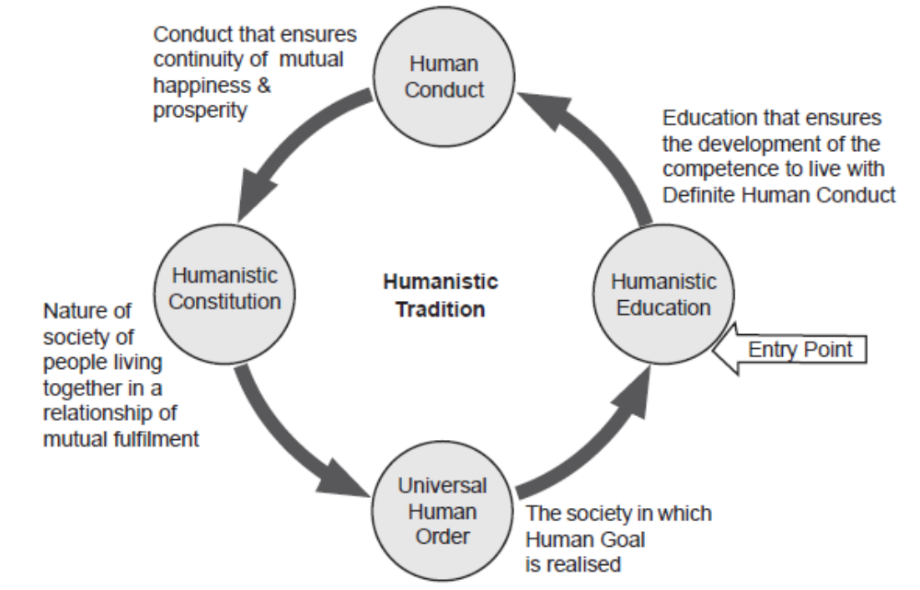
C. Holistic Development towards Universal Human Order
Paving Way towards the Humanistic Tradition
Humanistic education-Human Conduct-Human Constitution- Universal Human Order

Slide 24
D. Vision for Holistic Technologies, Production Systems and Management Models
A Holistic Criteria for Evaluation
Generally speaking, there are three broad criteria to guide the development of such technologies and systems, i.e.,
(a) Catering to appropriate needs and lifestyles
(b) Eco-friendly (cyclic / renewable and mutually enriching)
(c) User-friendly – safe, economical and enhancing human capability

Slide 25
D. Vision for Holistic Technologies, Production Systems and Management Models
Criteria for Technologies
The above-mentioned general criteria can be itemized into more specific form as follows:
Catering to real human needs
Compatible with natural systems and cycles Facilitating effective utilization of human body, animals, plants and other natural materials
Safe, user-friendly and conducive to health
Producible with local resources and expertise as far as possible
Promoting the use of renewable energy resources
Low cost and energy efficient
Enhancing human interaction and cooperation
Promoting decentralization
Durability, life cycle and recyclability of products

Slide 26
D. Vision for Holistic Technologies, Production Systems and Management Models
Criteria for Production Systems
The specific criteria to judge the appropriateness of the production systems may include the following:
Optimal and efficient utilization of local resources and expertise, including human
beings, animals, air, solar, land, water, bio and mineral resources etc.
Economic viability and sustainability
Priority for local consumption
Matching the pattern of production with the availability/producibility in the local
environment and the pattern of consumption
Decentralized systems capable of meaningful employment of people in the community
Facilitating production by masses and not mass production in a centralized mode to the extent possible
Promoting individual creativity and sense of accomplishment
Using people-friendly and eco-friendly technologies
Ensuring requisite quality of production
Safe and conducive to the health of persons involved in production as well as others
Harnessing recycling, conservation and reuse possibilities

Slide 27
Working with Nature
Working with material things, we have two values:
Utility-value: The participation of a human being in ensuring the role of physical facility in nurture, protection and providing means for the body.
Artistic-value: The participation of a human being in ensuring the role of physical facility to help and preserve its utility.

Slide 28
D. Vision for Holistic Technologies, Production Systems and Management Models
Criteria for Management Models
The whole unit working as a well-knit family
Cooperative, motivational and mutually fulfilling
Ensuring correct appraisal of human labour and skills
Targeting employer-employee as well as consumer satisfaction and not profit maximization
Sharing of responsibility and participative mode of management
Continuous value addition of the persons involved
Effectively integrating individual competencies and complementarity

Slide 29
D. Vision for Holistic Technologies, Production Systems and Management Models
Typical Examples from Traditional Technologies and Systems
The water harvesting and storage and utilization systems through ponds and other artifacts
Traditional agricultural practices
Traditional local remedies and health-care techniques
Grain storage and food preservation practices
Yoga, ayurveda, naturopathy-based healthcare systems
The system to share food prevalent in religious institutions
Family based rural enterprises
The relationship-based village system to ensure rural self-sufficiency
Rural craft and artisanal practices

